Slide 1
Product Owner Play book In Scrum Team
Compiled by Oliver Yang
Sep 7, 2016
http://oliveryang.net

Slide 2
Agenda
Product Owner & Scrum
Product Backlog Basic
PO Scrum Activities

Slide 3
Product owner stories
As a product owner, I need to drive a visionary product ROADMAP and PLAN, so that the product could win in the market.
AS a product owner, I need to drive a clear definition of READY and DONE, so that I could maximize the value of product and of the team.
Today’s Topic

Slide 4
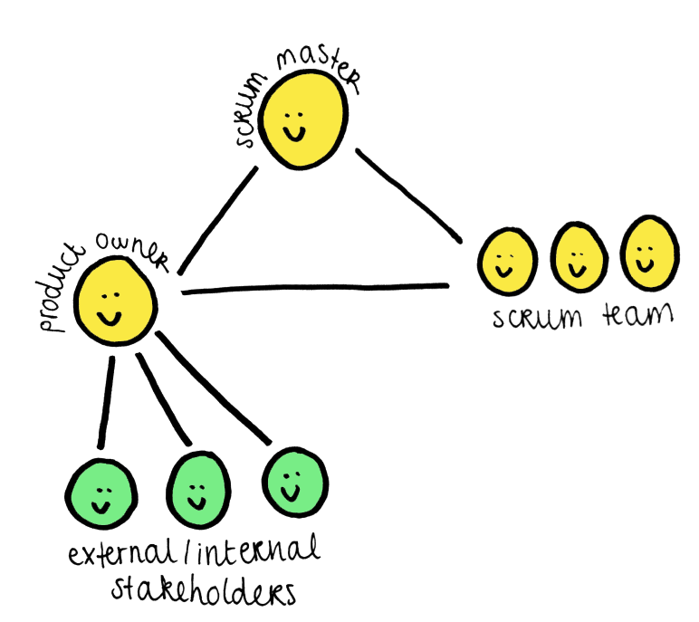
Product Owner
Work Values
Accountable for winning in the market
Maximizing the value of the product and of the dev team by clear the definition of read and done
Time Application
50% time on external people
Customer, Sales & Marketing, Architect, Stakeholders
50% time in scrum team
Output
Product vision, Product roadmap, Release plan
Product Backlog (owner)
Sprint Backlog (Constultant)
Product Increment (accept/reject)
Skill Requirements
Domain knowledge
People skills
Other soft skills

Slide 5
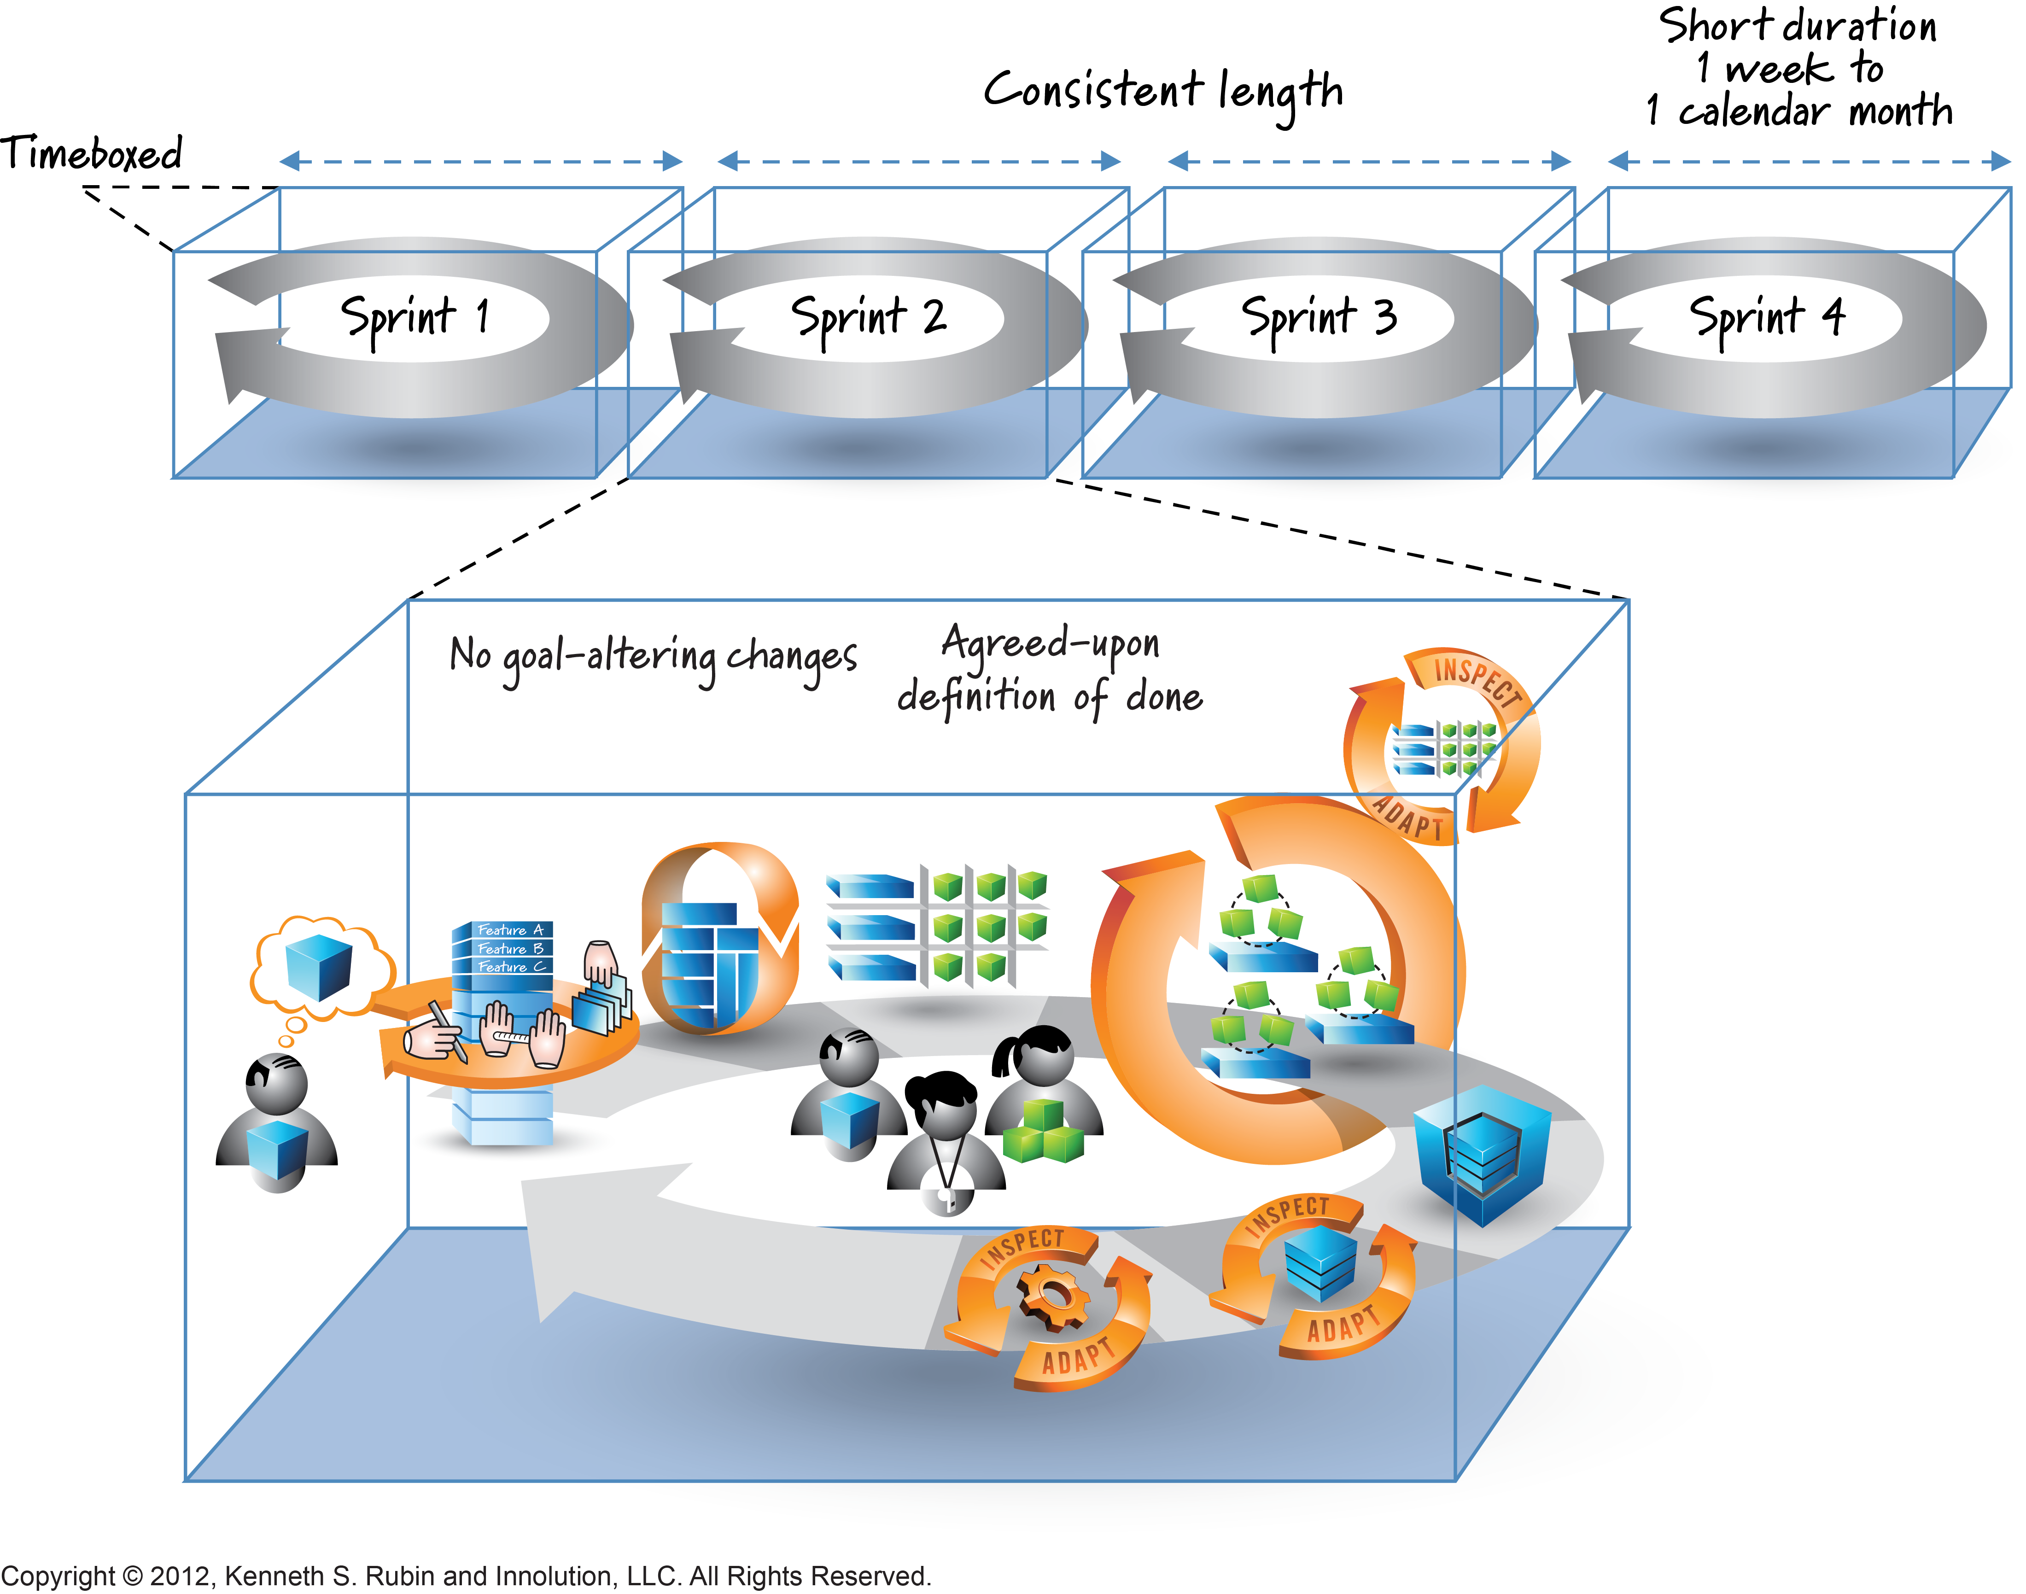
Scrum Activities

Slide 6
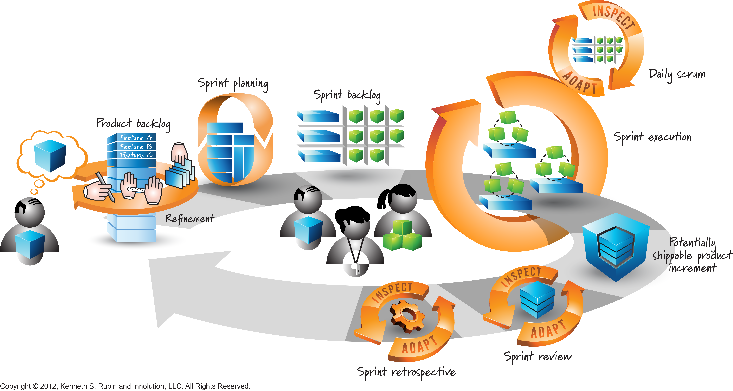
One sprint

Slide 7
Agenda
Product Owner & Scrum
Product Backlog Basic
PO Scrum Activities

Slide 8
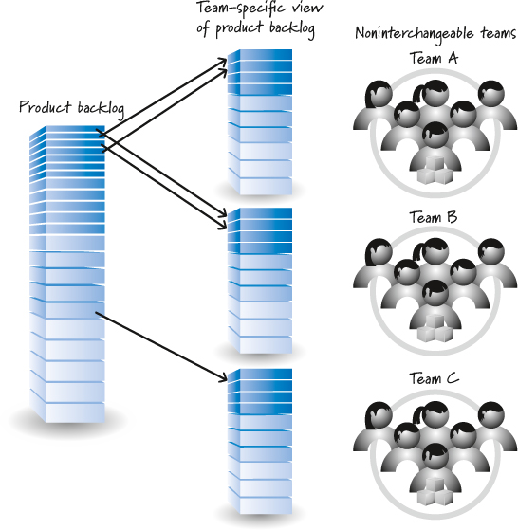
Product Backlog
PB – Product Backlog
An ordered list for things (PBIs) need to be done by Scrum team
Large Products - Hierarchical Backlogs
Need hierarchical PO
Multiple Teams - One Product Backlog
Good: Interchangeable teams
Bad: Different teams with special skills
One Team - Multiple Products
Merge to one PBI to have global priroty
PBI – Product Backlog Item
Whatever must be done to successfully deliver a product

Slide 9
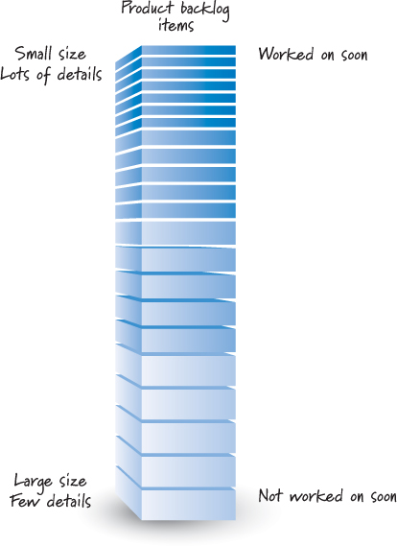
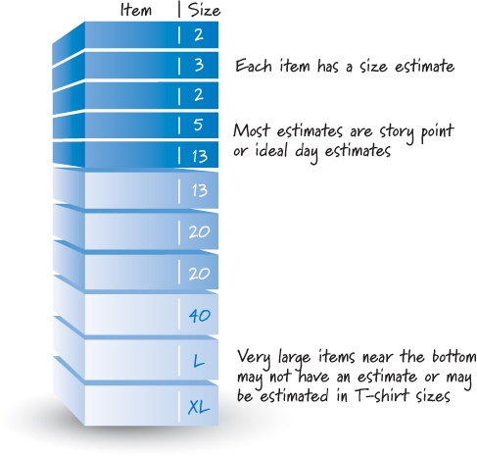
Product Backlog ABC - Size

Slide 10
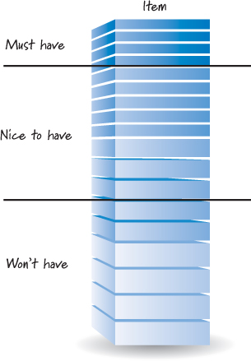
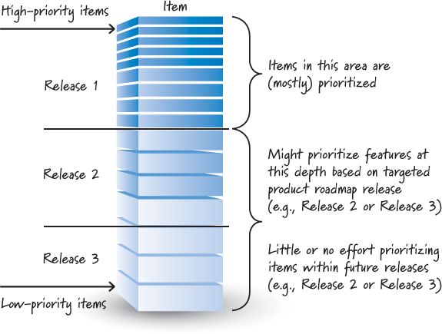
Product Backlog ABC - Priority

Slide 11
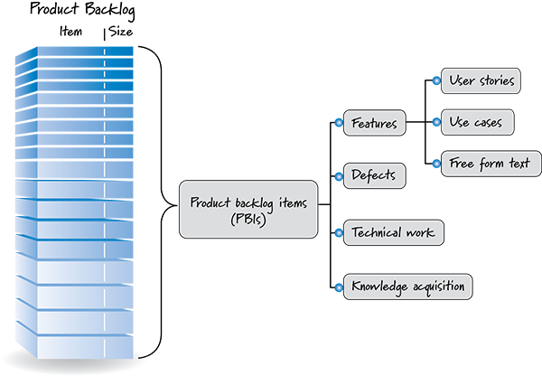
Product Backlog ABC - TYpe

Slide 12
User Story Generation
End to End user story
User Story Template
Who: AS a <Role>
What: I want <Activity>
Why: so that <Business Value>
Good user story should be INVEST
Independent
Negotiable
Valuable
Estimable
Sized appropriately (Small, < 1/4 sprint)
Testable

Slide 13
Agenda
Product Owner & Scrum
Product Backlog Basic
PO Scrum Activities

Slide 14
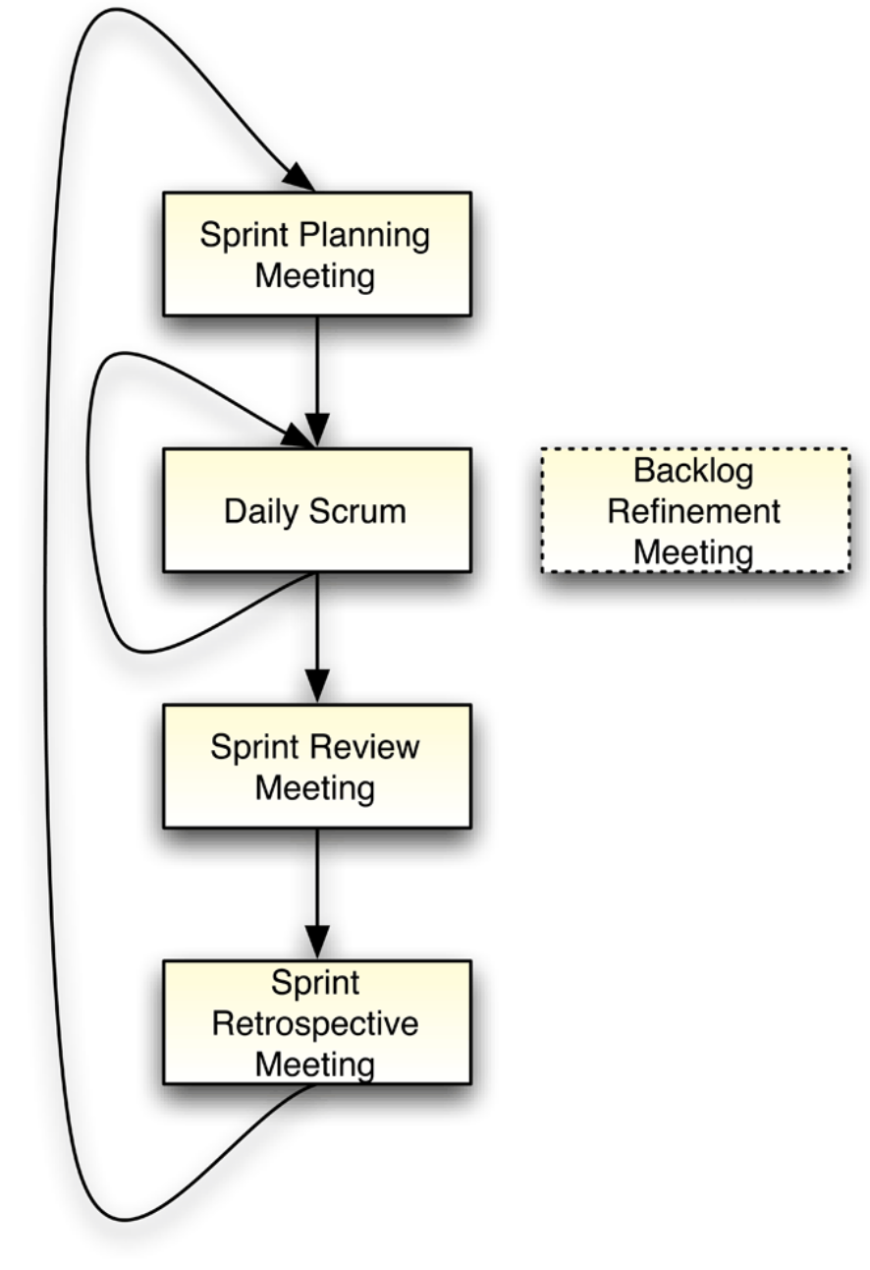
PO Scrum Activities Overview
Activities in 5 meetings
Backlog Grooming Meeting (Key Role)
Scrum Planning Meeting (Key Role)
Daily Scrum (Optional)
Sprint Review Meeting (Key Role)
Sprint Retrospective Meeting (Member)
Offline activities
Flow management
PB grooming discussions
Brainstorming, discussion for PI planning
Customer requirements clarification
…

Slide 15
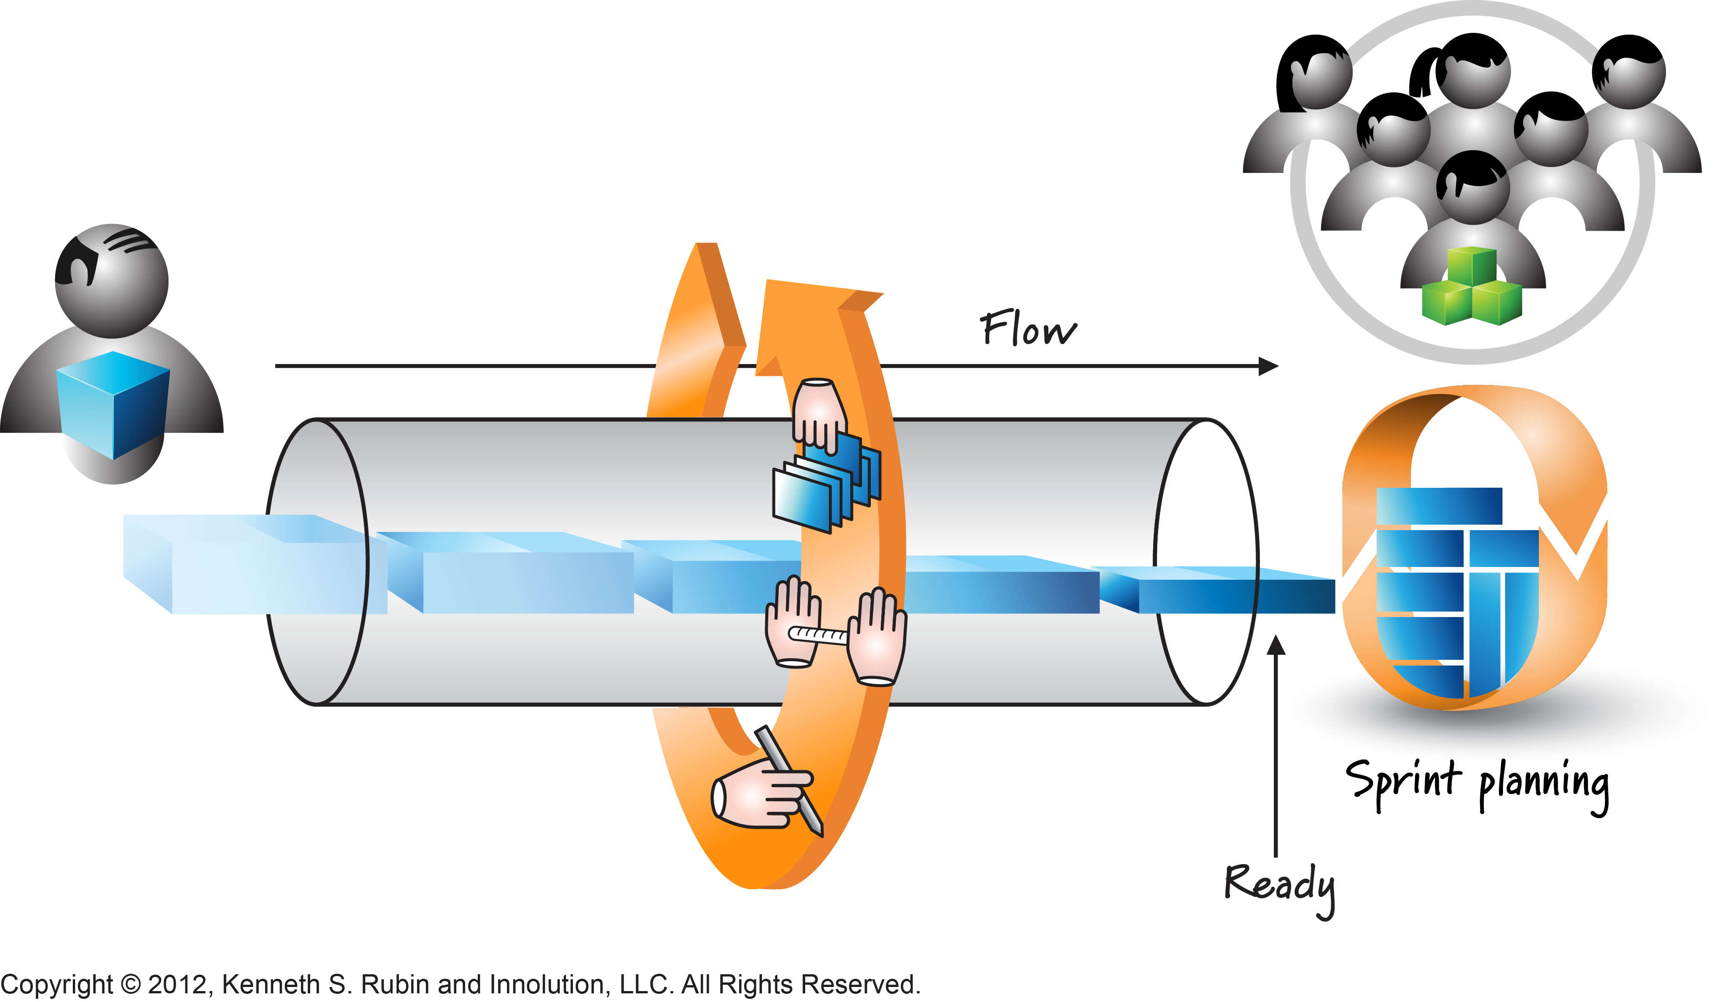
Flow Management
Release flow management
Backlog grooming
PBI is under healthy status
Ready for Release planning
Release planning
Release plan
Sprint flow management
Backlog grooming
PBI is under healthy status
Sprint planning
PBI ready for planning

Slide 16
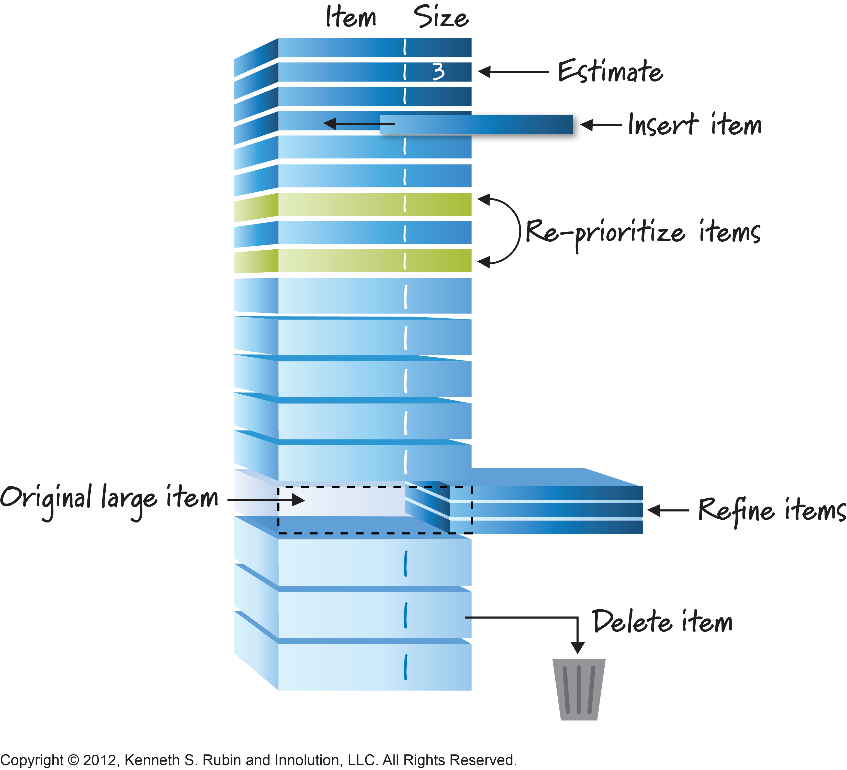
PO in Backlog Grooming Meeting
Time
Per requirements after middle of sprint
Multiple meetings per sprint
5~10% of one sprint time
Attendee
Scrum Team
Anyone that could help on PBI definitions
Outcome
PO drive and make PBIs ready for next 1~3 sprints
Do estimation per user story (should done by dev team)
PO drive and ensure long term PBIs is under healthy status by backlog refinement

Slide 17
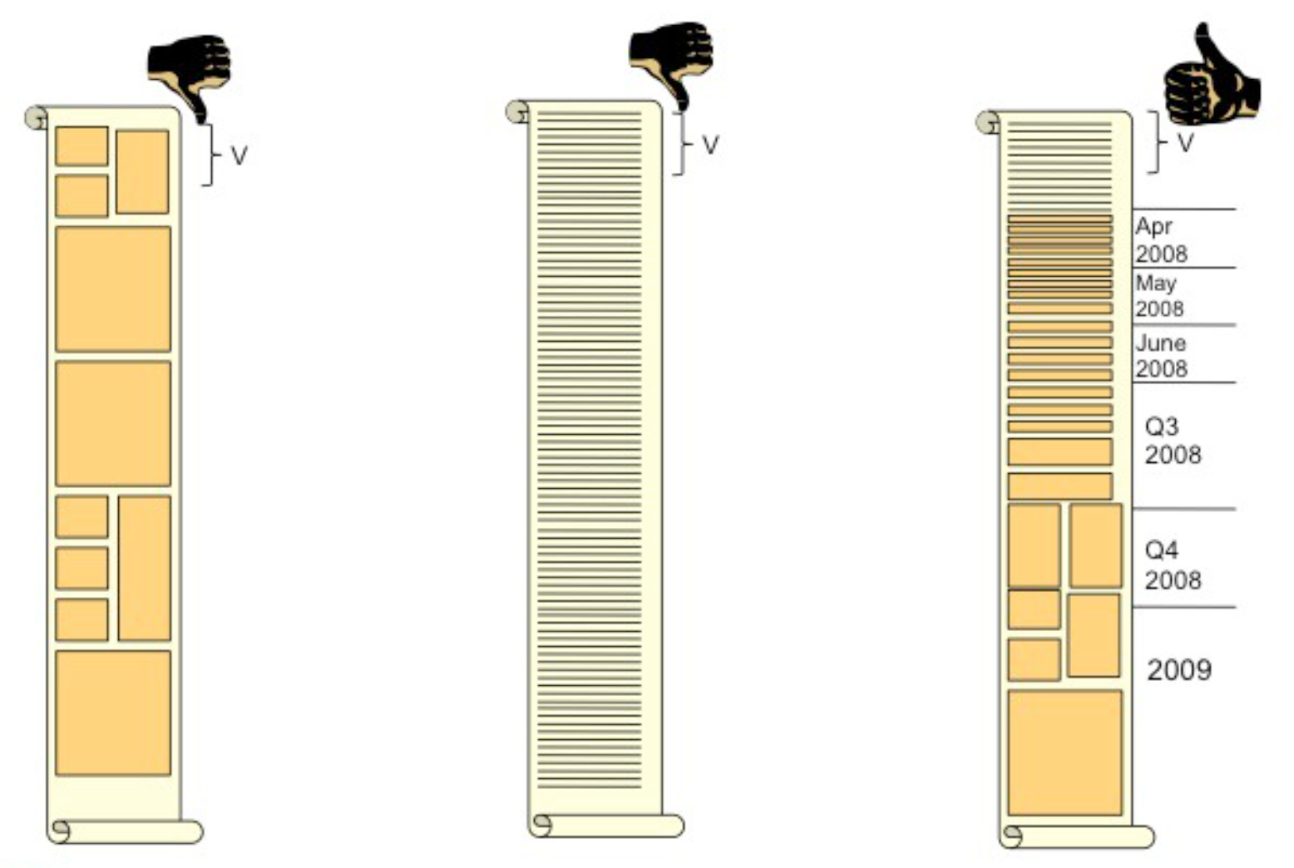
A Healthy Project Backlogs

Slide 18
User story Split
User story split
Owner: PO
What
Break down big features or user stories
Why
A user story might be too big to complete in a sprint
For example, 4 weeks sprint cycle, > 5 days should be split
When
Good: Most of should be done during backlog grooming and refinement
Not good: Few of them might be done on sprint planning meeting
How
Vertical slicing to ensure end to end user story

Slide 19
User story split strategy
Splitting on data
Splitting on operations (eg, CRUD)
Splitting on workflow steps
Splitting with simple/complex scenarios
Splitting with simple/complex rules
Splitting via I/O pathway
Splitting by acceptance test
Splitting functional and non-functional
Stubbing out external dependencies
Splitting by having enabler stories (AKA. Spike)
Mindmap for user story split

Slide 20
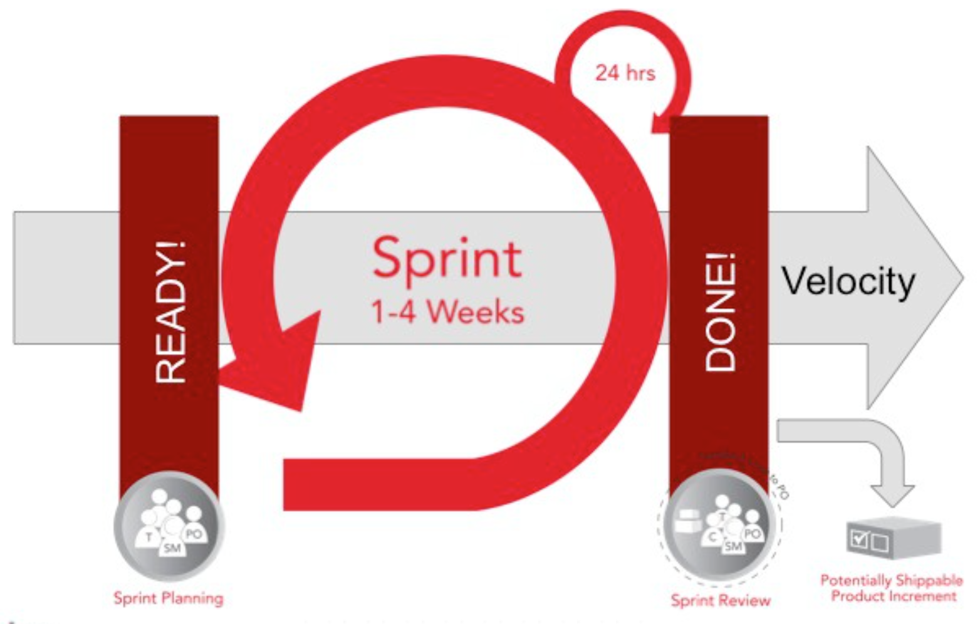
Ready – PBI DOR (Definition of Ready)
Ready User Stories that can reach DONE
are key to team success!
DOR Check List

Slide 21
PO in Sprint Planning Meeting
Time
Beginning of sprint and 1 time meeting
4 hours for 4 weeks sprint
Attendee
Scrum team
Others that can help on PBIs and SB definitions
Outcome
Communication between PO and Dev team, other conversation need to be controlled
What: Evaluate PBIs and set sprint goals with PO
PO clarify user stories and team need understand
PO need address questions for team
Team capacity planning per velocity
Already knew DoD scope or need update scope
Pick up PBIs and add them into SB until reach capacity

Slide 22
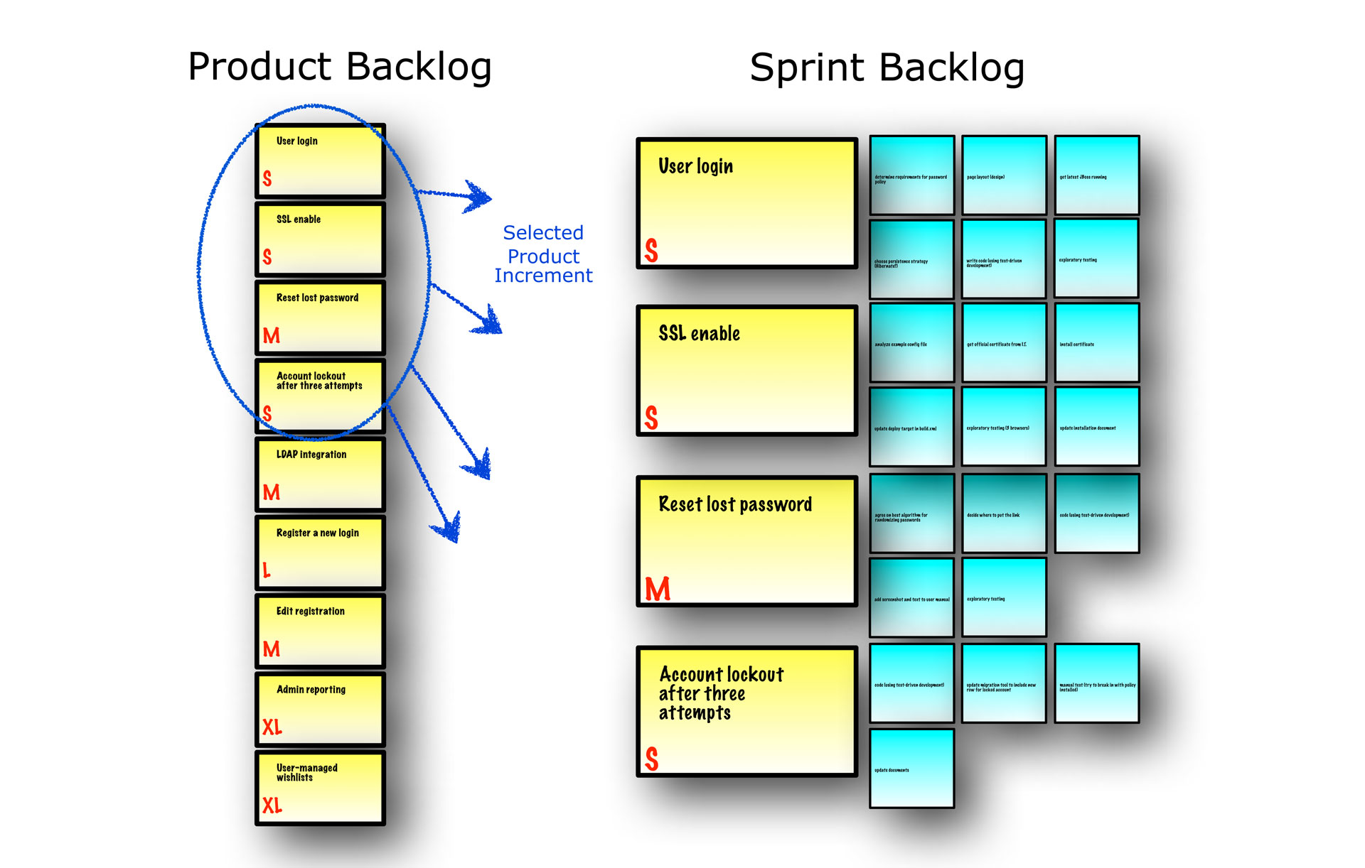
Sprint Backlog
Sprint Backlog
The list of work the dev team must address in next Sprint.
Created on Sprint Planning meeting
Pickup from top PBIs of PB
Until reach the team velocity

Slide 23
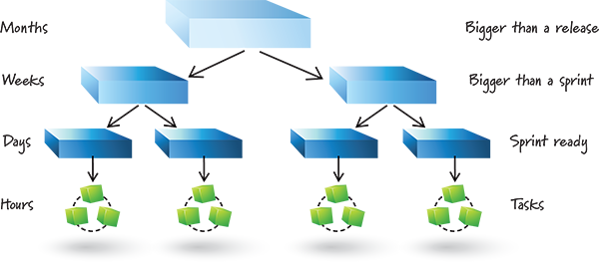
Sprint Planning Scope

Slide 24
task break down
Owner: Dev team
What
Planning user story implementation from sprint backlog
Why
Very important to have effective daily scrum meeting
How
Pick up User Stories from PBIs and do task break down
Hourly granularity, big task needs a split, don't exceed 8 hours
No task pre-assignment
Task Estimation
With amount of hour, just a good guess, not a commitment
Team upgrade remaining hours daily before daily scrum meeting
Dev team could change tasks of a PBI freely
Different with sprint backlog
Once Sprint backlog is committed, no PBIs could be added

Slide 25
DONe – Sprint DoD & User story AC
 | Definition of Done | Accept Criteria
Owner | Owner: Dev Team | PO is AC owner
Purpose | Clear what Dev & QA work should be done before a PBI is claimed as done | Clear of business requirement clarification so that satisfy customers
Scope | DoD is uniformed for all PBIs/User stories | AC is per PBI/User story
Stability | After team agreement, DoD can‘t be changed frequently, and should be frozen in the Sprint | AC is negotiable and could be changed
Results | Meet DoD ensures the implementation meets AC | Meet AC can’t ensure DoD is meet too
Pitfalls | Poor DoD causes, Compromise product quality Cause unnecessary bug fix & test sprints Increasing technical debts | Poor AC causes Can’t satisfy customer Work rejected which can be avoided

Slide 26
Defination of Done Examples
Dev
Unit test
Test
Test case dev
Document
Dev design doc
TOI doc
Code review
Code commit
Brach merge
Zero defects
Functional
Regression
System integration
Performance regression
User doc
Release notes
Test design doc
Meet AC

Slide 27
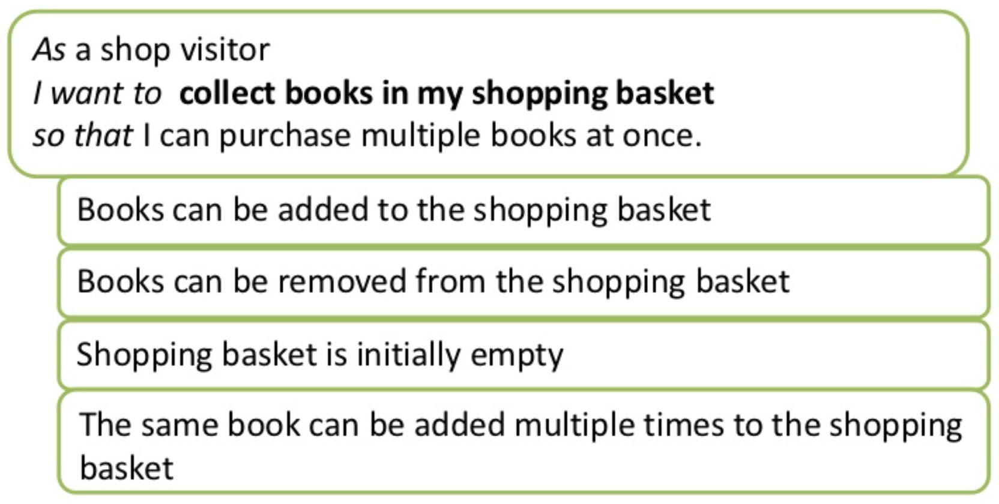
Accept Criteria Examples

Slide 28
PO in Sprint Review Meeting
Time
End of sprint and 1 time meeting
2 hours per two weeks time boxed
Attendee
Scrum Team
Customers, Stakeholders, Managers
Outcome
PO identifies what had been done and what hasn't been done
Team demonstrates the work had been done and answer the questions
Demo deliverables (key PBIs, Working software, Documents, insted of PPT)
PO Accept/Reject work per DoD and AC
Build trust between PO with customers & stakeholders
Get feedbacks from customers & stakeholders
PO projects likely release completion date with different velocity assumptions
Team decisions communications

Slide 29
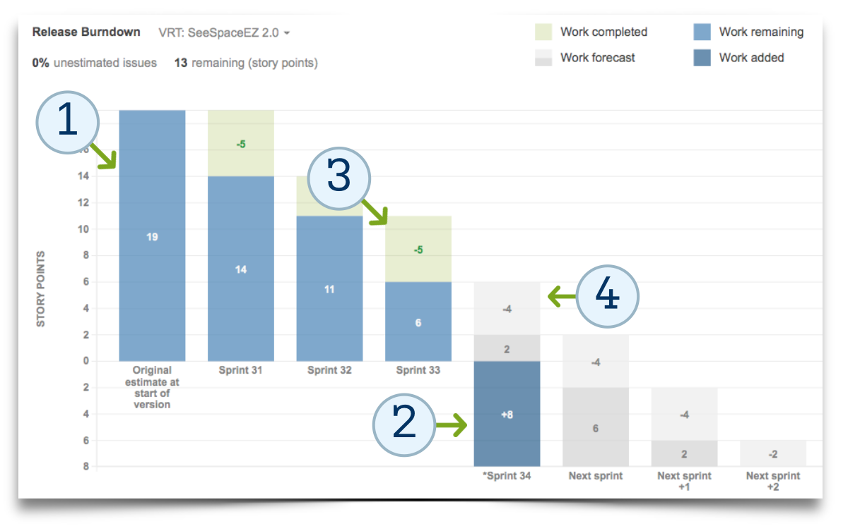
Release burn-down: project release date
Notes:
Green line:
Normal velocity
Blue line:
Optimistic velocity
Red line:
Scope changes
3 lines cross points are
release date: optimistic date & normal date
Day1
Day2

Slide 30
Scenario Discussion
Backlog Grooming
Define tasks in product backlog
Sprint Planning
Enter sprint planning without PBI DOR
Sprint Review
Don’t demo for key user stories
Horizontal user stories slicing, not end to end
PBI of next 1~2 sprint is not reach DOR
No clear unique priority definitions
No accept criteria
Task pre-assignment do what you could do without business driven
QA and Dev tasks are not grouped under user stories
Don’t have task estimation
Dev team don’t have DoD
No team capacity planning
Don’t got through accept and reject review
No release completion date updates per velocity

Slide 31
Q & A

